Slide 1
Getting started with Django Framework
Ami Patel

Slide 2
Web Framework
Web framework is a set of components designed to simplify your web development process. It has basic structuring tools in it, which serve as a solid base for your project.

Slide 3
What is Django???
Django is a high-level Python web development framework.
Open Source
World Online, a web newspaper, was in need of software that could meet deadlines.
The Django is very demanding due to its rapid development feature.
It takes less time to build application after collecting client requirement.
Django inherited Python’s “batteries-included” approach.
It also includes pre-made modules and applications for common tasks in web development like
• User authentication,
• templates,
• routes, and views,
• admin interface,
• robust security and
• support for multiple database backends.
It is based on MVT (Model View Template)design pattern.

Slide 4
Examples of Companies Using Django
Instagram
National Geographic
Mozilla
Spotify
Pinterest
Disqus
Bitbucket
Eventbrite
Prezi

Slide 5
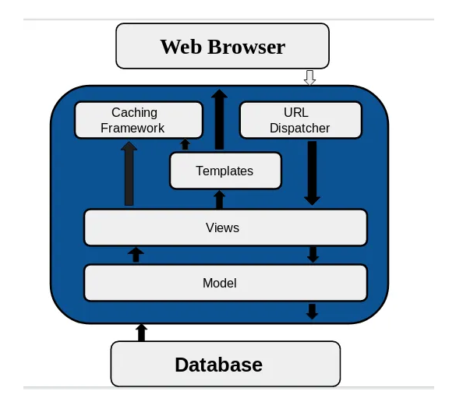
Django Work Flow

Slide 6
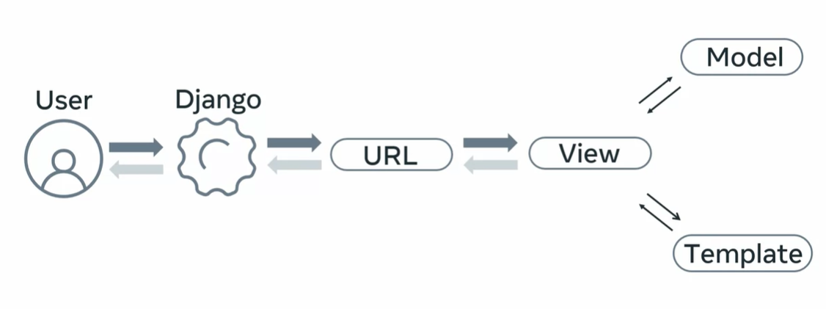
Django flow

Slide 7
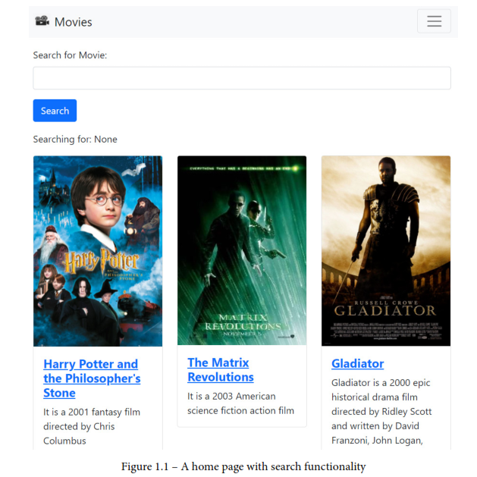
Understanding the app we will be building

Slide 8
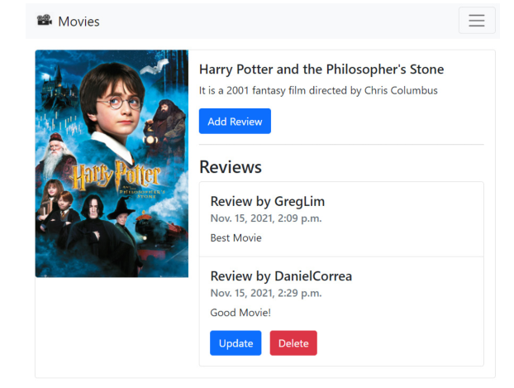
Users will also be able to log in and post reviews of any movies they may have watched, as shown in figure

Slide 9
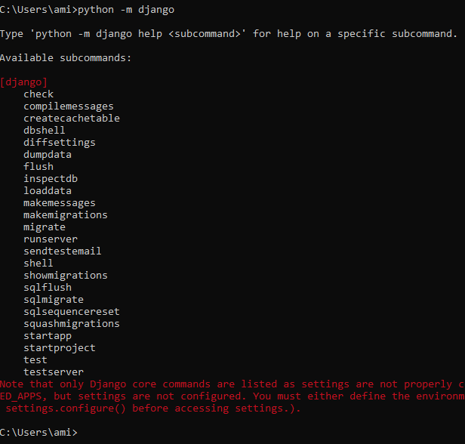
Installing Python For Windows, run this:
python --version
Installing Django For Windows, run this:
pip install Django==4.0
Ensure you have installed Django by running the following command.
python -m django

Slide 10
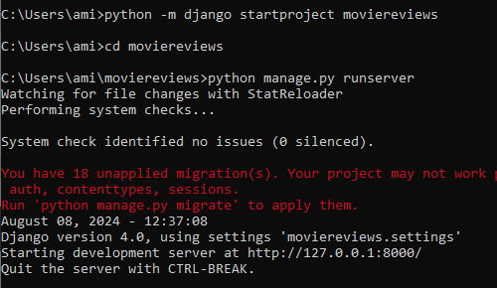
To create a new project
In the Terminal, navigate to a folder on your computer where you want to store your Django project, such as Desktop. In that folder, you will run a command like this:
python -m django startproject moviereviews
Running the Django local web server
In the Terminal, cd into the created folder:
cd moviereviews
python manage.py runserver
1
2
3

Slide 11
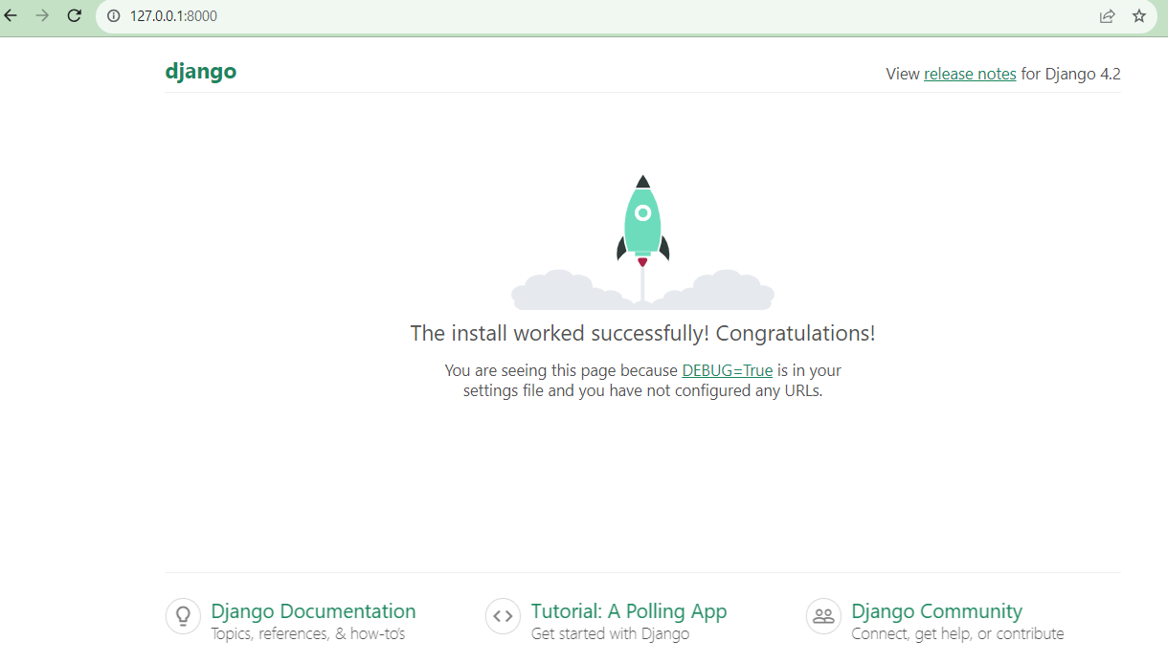
Copy the url (http://127.0.0.1:8000/ )and open it in the browser. If you see the below screen, that means everything was successful.

Slide 12
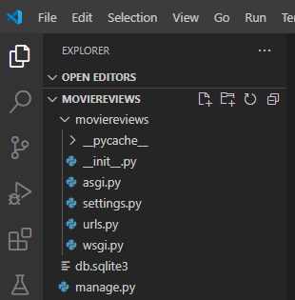
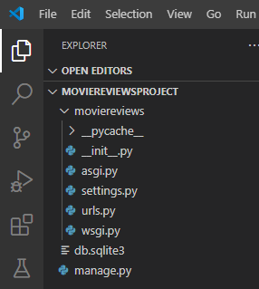
Open VS Code, open the folder moviereviews.
To avoid confusion and to distinguish between the two moviereviews folders, we will keep the inner moviereviews folder as it is and rename the outer folder moviereviewsproject.

Slide 13
all the files created by default
manage.py: allows us to execute all the code. DO NOT MAKE ANY CHANGES TO IT.
db.sqlite3: the default sqlite database that comes with Django.
wsgi.py: web server gateway interface allows us to create the Django server
urls.py: contains a list of url paths for routing across the website
asgi.py: is for asynchronous calls (Async programming in Python. Asynchronous programming is a characteristic of modern programming languages that allows an application to perform various operations without waiting for any of them.)
settings.py: is the core command centre of the project. It connects everything: apps, templates, databases, urls, static files, etc.
Apps are small components that handle different pages of a website.

Slide 14
settings.py
BASE_DIR: Determines where on your machine the project is situated.
SECRET_KEY: Used when you have data flowing in and out of your website. Do not ever share this with others.
DEBUG: Our site can run in debug mode or not. In debug mode, we get detailed information on errors – for instance, if we try to run http://localhost:8000/123 in the browser, we will see a Page not found (404) error:
INSTALLED_APPS: Allows us to bring different pieces of code into our project.
We will see this in action later.
MIDDLEWARE: Refers to built-in Django functions to process application requests/responses, which include authentication, session, and security.
ROOT_URLCONF: Specifies where our URLs are.
TEMPLATES: Defines the template engine class, the list of directories where the engine should look for template source files, and specific template settings.
AUTH_PASSWORD_VALIDATORS: Allow us to specify the validations that we want on passwords – for example, a minimum length.

Slide 15
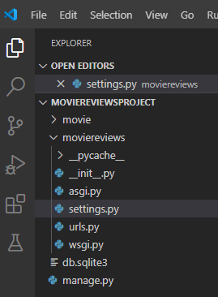
Creating our first app
A single Django project can contain one or more apps that work together to power a web application. Django uses the concept of projects and apps to keep code clean and readable.
Apps in Django are like pieces of a website. You can create an entire website with one single app, but it is useful to break it up into different apps, each representing a clear function.
Our movie review site will begin with one app.
python manage.py startapp movie
A new folder, movie, will be added to the project.

Slide 16
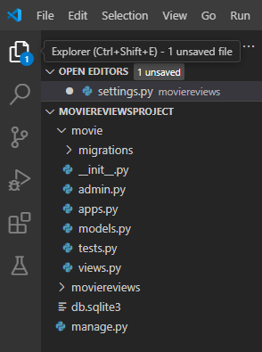
Files created in movie
Meanings of all the files in this folder:
views.py: take care of things like urls and databases
models.py: where we will configure the database
admin.py: to run the admin panel
apps.py: for core app integration
tests.py: to run unit tests for our application

Slide 17
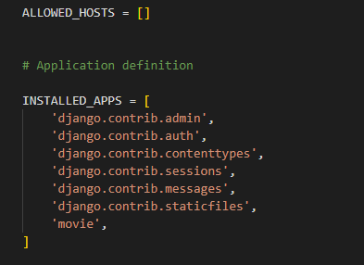
Add movie to settings.py
At this point, the project doesn’t know about the existence of the movie. So go to settings.py file in the project and add the app in the following way:
Back in the Terminal, run the server:
python manage.py runserver

Slide 18
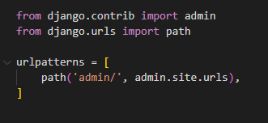
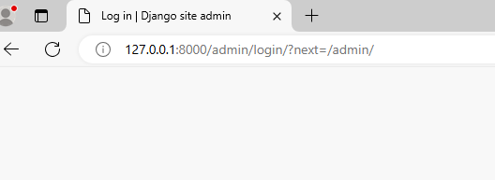
Managing Django URLs
urls.py currently has the following code:
When a request passes through urls.py, it will try to match a path object in url patterns – for example, if a user enters http://localhost:8000/admin into the browser, the URL will match the admin/ path. The server will then respond with the Django admin site, which we will explore later:

Slide 19
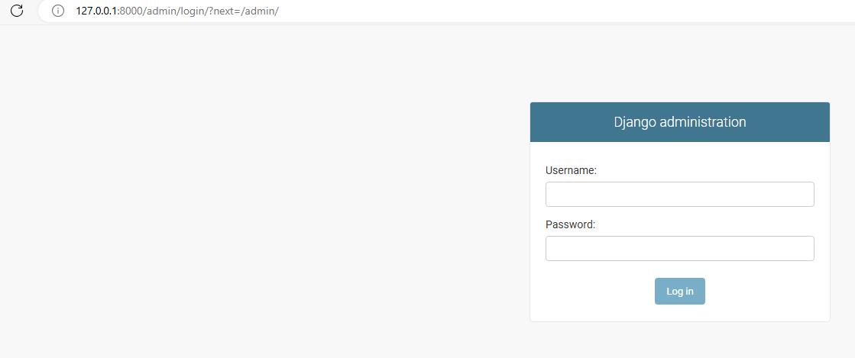

Slide 20
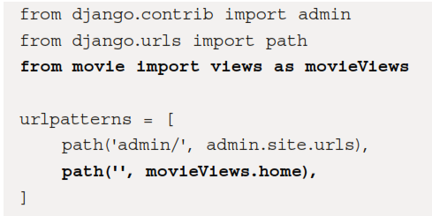
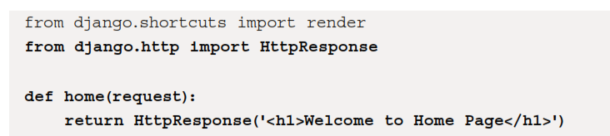
Creating a custom path for a home page
Add the following code in bold into urls.py:
/movie/views.py
In views.py, add the following in bold:

Slide 21
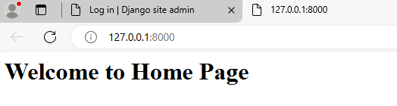
Home page View
Now open this link on the browser: http://127.0.0.1:8000

Slide 22
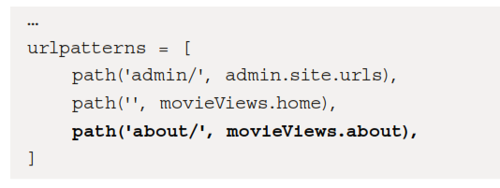
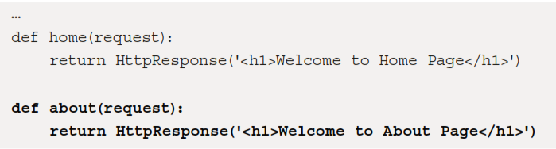
Creating a custom path for an about page
In /moviereviews/urls.py, add the path in bold:
if a URL matches the about/ path, it will return the about function. Let's create the
about function in /movie/views.py:

Slide 23
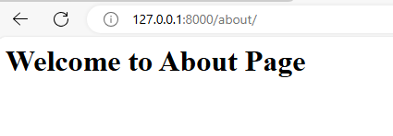
Now open this link on the browser: http://127.0.0.1:8000/about/

Slide 24
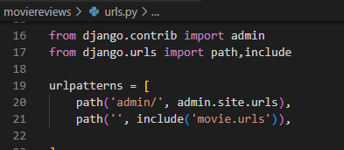
Create url.py in movie
Ideally, for large project, it is not advisable to do the routing in this way. Every app should have its own urls.py file. So delete the changes you made to the urls.py file of the moviereviews and create a new file urls.py in the movie.
The urls.py file in moviereviews contains the following code now:

Slide 25
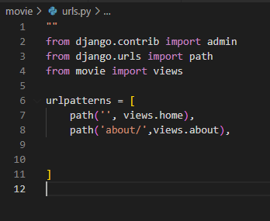
Make following changes in urls.py in movie

Slide 26
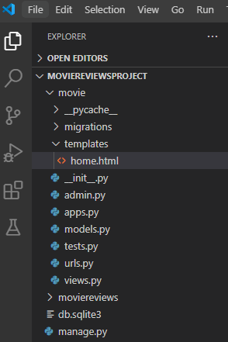
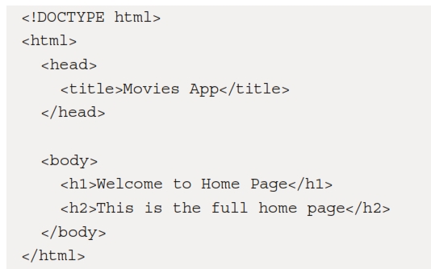
Generating HTML Pages with Templates
/movie/templates/ ,create a new file, home.html.create a home.html file in it with the following code:

Slide 27
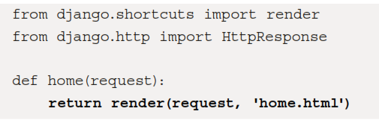
/movie/views.py, make the following change in bold to the home function:

Slide 28
Passing data into templates
Add the following in bold to/movie/views.py:
def home(request):
return render(request, 'home.html', {'name':'Greg Lim'})
And in home.html,
<body>
<h1>Welcome to Home Page, {{ name }}</h1>
<h2>This is the full home page</h2>
</body>

Slide 29
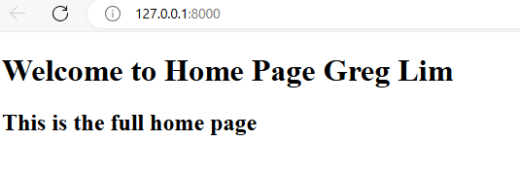
Now open this link on the browser: http://127.0.0.1:8000
we used the variable syntax element from the Django Template
Language (DTL). The DTL provides a set of elements and tags – for example, {{ … }}

Slide 30
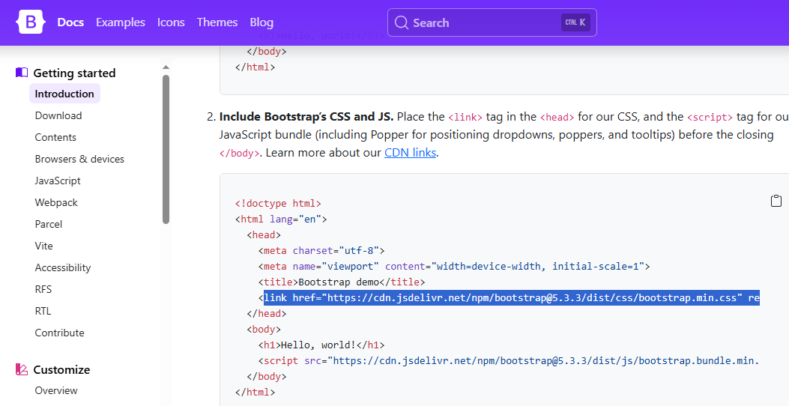
Adding Bootstrap to our site
Go to https://getbootstrap.com/ and go to Get started, then Copy the style sheet link (as shown in Figure 4.5) inside the <head> tag of the home.html template to load the Bootstrap CSS:

Slide 31

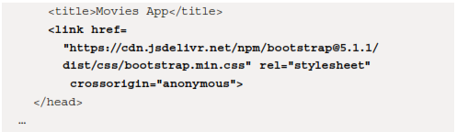
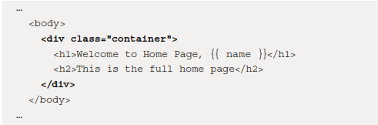
load the Bootstrap CSS link to home.html
You c a n immediately see the styling applied if you go to localhost:8000
To improve the padding of the site, let's wrap the home.html HTML header tags in a div container:

Slide 32
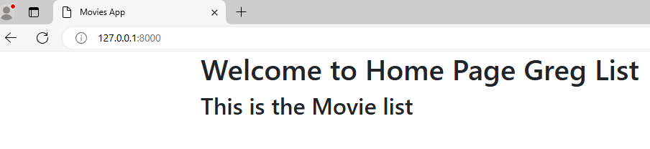
open this link on the browser: http://127.0.0.1:8000

Slide 33
Make following updates in movie/views.py
from django.shortcuts import render
from django.http import HttpResponse
movie_list=[
{'id':1,'name': 'Hetty potter'},
{'id':2,'name':'Gladiator'},
{'id':3,'name':'Misson Impossible'}]
def home(request):
return render(request, 'home.html',{'name’: 'Greg Lim','movie_list’: movie_list})
def about(request):
return render(request, 'about.html')

Slide 34
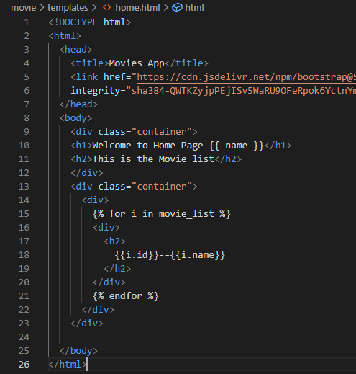
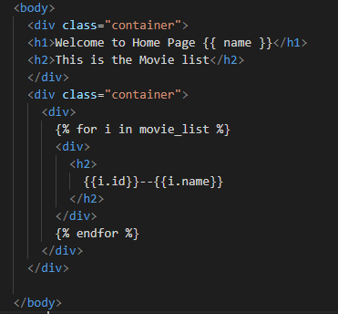
Make following updates in movie/templates/home.html

Slide 35
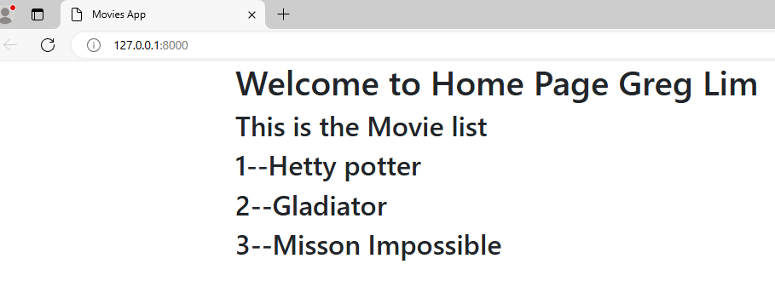
open this link on the browser: http://127.0.0.1:8000

Slide 36
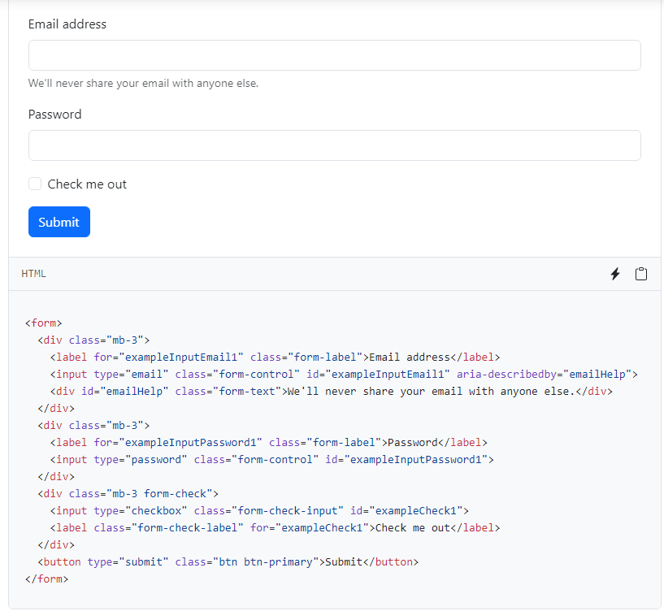
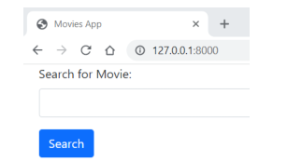
Adding a search form
At
https://getbootstrap.com, under
Docs, go to Forms | Overview

Slide 37
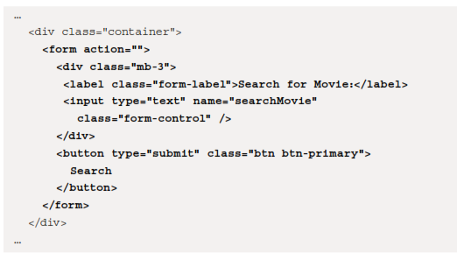
Add the following in bold to the home.html

Slide 38

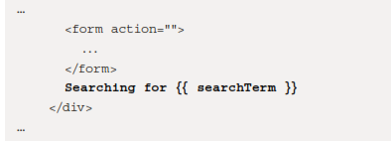
movie/views.py
movie/templates/home.html
We then pass searchTerm into home.html in the render function with
{'searchTerm':searchTerm}. Add the following code in bold to home.html:

Slide 39
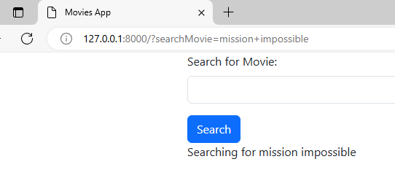
open this link on the browser: http://127.0.0.1:8000

Slide 40
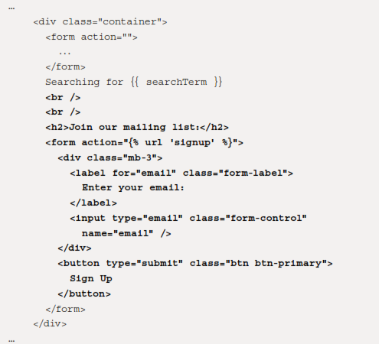
Sending a form to another page(home.html)
The signup form is similar to the search form. We have an email input and a Sign Up button. What is different is in the <form> tag,
<form action="{% url 'signup' %}">.
The url template tag {% url 'signup' %} takes a URL pattern name – for example
'signup' – and returns a URL link.

Slide 41
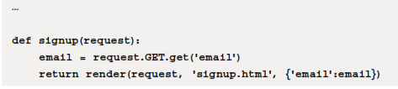
now add the 'signup' route to urlpatterns in /movie/urls.py:
/movie/views.py
Next, in movie/views.py, add the signup function (similar to home):
from django.contrib import admin
from django.urls import path
from movie import views
urlpatterns = [
path('', views.home),
path('about/',views.about),
path('signup/', views.signup,name='signup'),
]

Slide 42
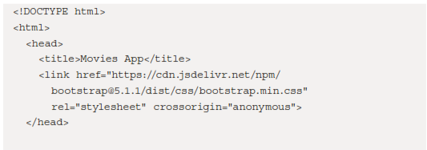
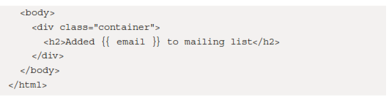
In movie/templates/, create a new file, signup.html, with the following markup:

Slide 43
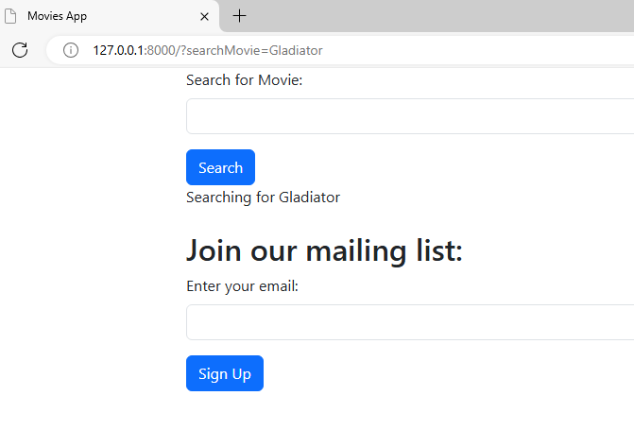
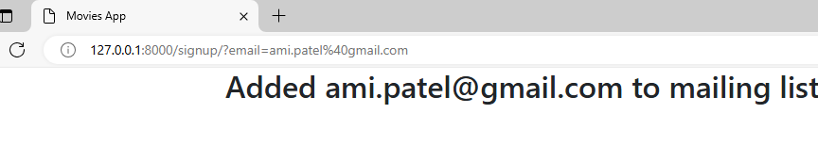
open this link on the browser: http://127.0.0.1:8000

Slide 44
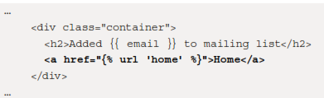
Creating a back link
we want to create a link from signup.html back to home.html. We can do so using the <a> tag. In signup.html, add the line in bold:
Do following highlighted changes
in /movie/urls.py:
from django.contrib import admin
from django.urls import path
from movie import views
urlpatterns = [
path('', views.home,name='home'),
path('about/',views.about,name='about'),
path('signup/', views.signup, name='signup'),
]

Slide 45
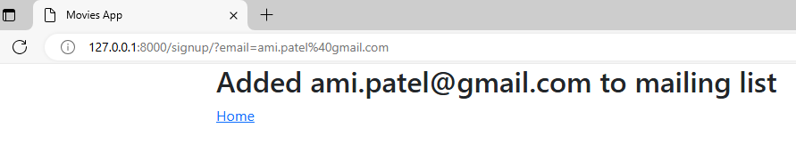
If you go to signup.html, you will see the following:

Slide 46
Thank you

